Slide 1

vehicle smart parking
Presenter Names:
N.Likhitha sahi - VU21CSEN0600125
V.Dharaneesh - VU21CSEN0600058
D.Sandeep - VU21CSEN0600077
S.Sri Pooja - VU21CSEN0600147
Guide Name:
Dr.Vikram Dhiman , CSE
CSE, GST, Visakhapatnam

Slide 2
Contents
1. Abstract
2. Introduction
3. Literature Review
4. Requirement Analysis
5. Design Analysis
6. Methodology/ Tools/Methods to be used
7. Implementation
8. Screenshots of the project
9. Results & Discussions
10. Conclusion and Future Scope
References
CSE, GST, Visakhapatnam

Slide 3
Abstract
Smart parking systems have become an essential solution for urban traffic congestion and inefficient parking management. This project focuses on implementing an advanced parking system that integrates real-time parking slot detection and navigation to available slots using computer vision and machine learning techniques. The system utilizes CCTV cameras to monitor parking slots, identifying whether they are occupied or vacant. The extracted data assists in guiding drivers to the nearest available parking space efficiently, reducing waiting time and traffic congestion
CSE, GST, Visakhapatnam

Slide 4
Introduction
With increasing urbanization, finding a parking space has become a significant challenge in metropolitan areas.
Traditional parking systems lack automation, leading to inefficient parking slot utilization and increased fuel consumption due to prolonged searching.
To address these issues, our smart parking system leverages computer vision and machine learning to automate parking slot detection and navigation assistance.
The system provides real-time data on slot availability and guides drivers to the nearest free parking space, ensuring a seamless and efficient parking experience.
CSE, GST, Visakhapatnam

Slide 5
Literature review
Publication | Name of the Author | Summary
Smart parking system for smart cities" (2015) | L. Mainetti, L. Patrono, A. Vilei | This paper presents a smart parking system that uses IoT sensors for real-time slot monitoring and user parking management via a mobile application, user management,reduced search time.
"Smart parking guidance system" (2018) | N. Bi, L. Ding | parking system integrating GPS and IoT to provide parking slot navigation particuraly in high traffic urban areas. Reduces congestion in large parking slots,
CSE, GST, Visakhapatnam

Slide 6
Literature review
Publication | Name of the Author | Summary
Greedy, A-Star, and Dijkstra’s Algorithms in Finding Shortest Path(2021) | M. R. Wayahdi, Subhan Hafiz Nanda Ginting, Dinur Syahputra | Dijkstra's algorithm is the most effective of the Greedy, A-Star, and Dijkstra algorithms in finding the shortest path in a graph or path.
CSE, GST, Visakhapatnam

Slide 7
Requirement Analysis
Hardware Requirements:
CCTV cameras for real-time video feed
Computational unit for processing (GPU-enabled system preferred)
Software Requirements:
Python for implementation
OpenCV for image processing
YOLO for vehicle detection
Functional Requirements:
Detect vacant and occupied parking slots using camera feeds
Provide real-time navigation assistance to drivers
Display parking slot status on a user-friendly interface
CSE, GST, Visakhapatnam

Slide 8
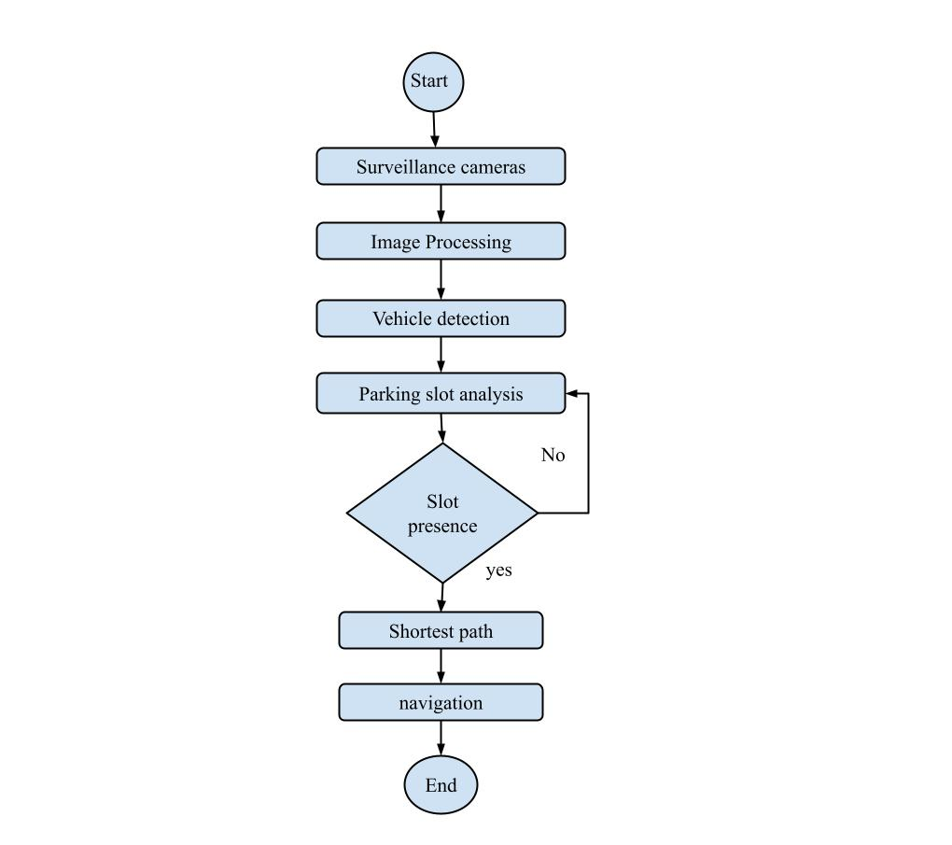
Design Analysis
Design Analysis: The system follows a structured workflow:
Data Collection: CCTV cameras capture real-time footage of the parking area.
Processing: The video feed is processed using OpenCV and YOLO to identify available and occupied slots.
Navigation System: The detected slot data is used to guide the driver to the nearest available slot via a web interface.
Real-Time Updates: Continuous monitoring ensures updated slot availability information for accurate navigation.
CSE, GST, Visakhapatnam

Slide 9
Tools
Programming Language: Python
Deep Learning Model: YOLO for vehicle detection
Image Processing: OpenCV
Hardware: CCTV cameras
CSE, GST, Visakhapatnam

Slide 10
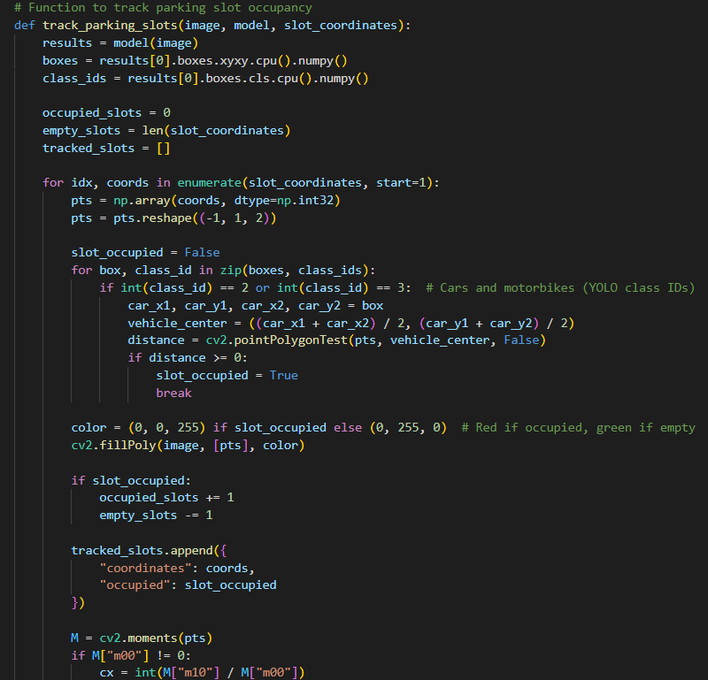
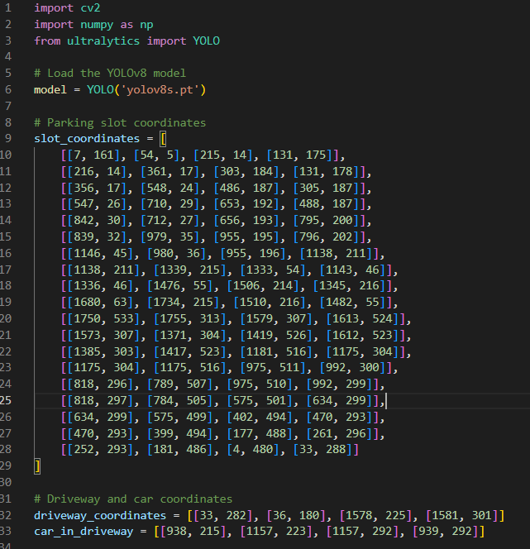
Implementation
CSE, GST, Visakhapatnam

Slide 11
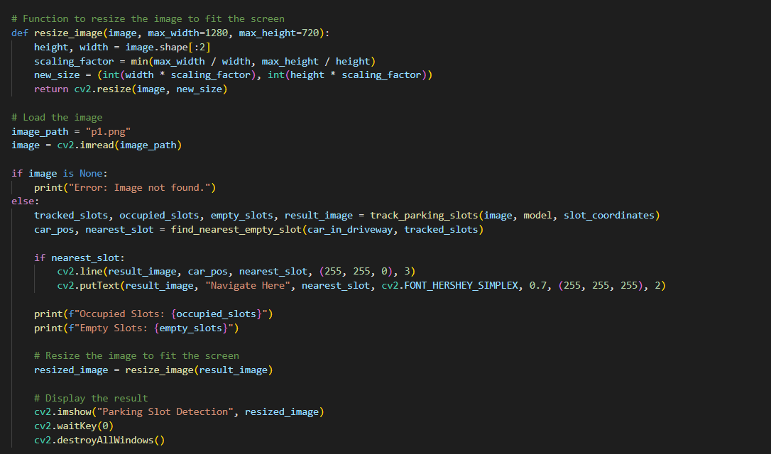
Implementation
CSE, GST, Visakhapatnam

Slide 12
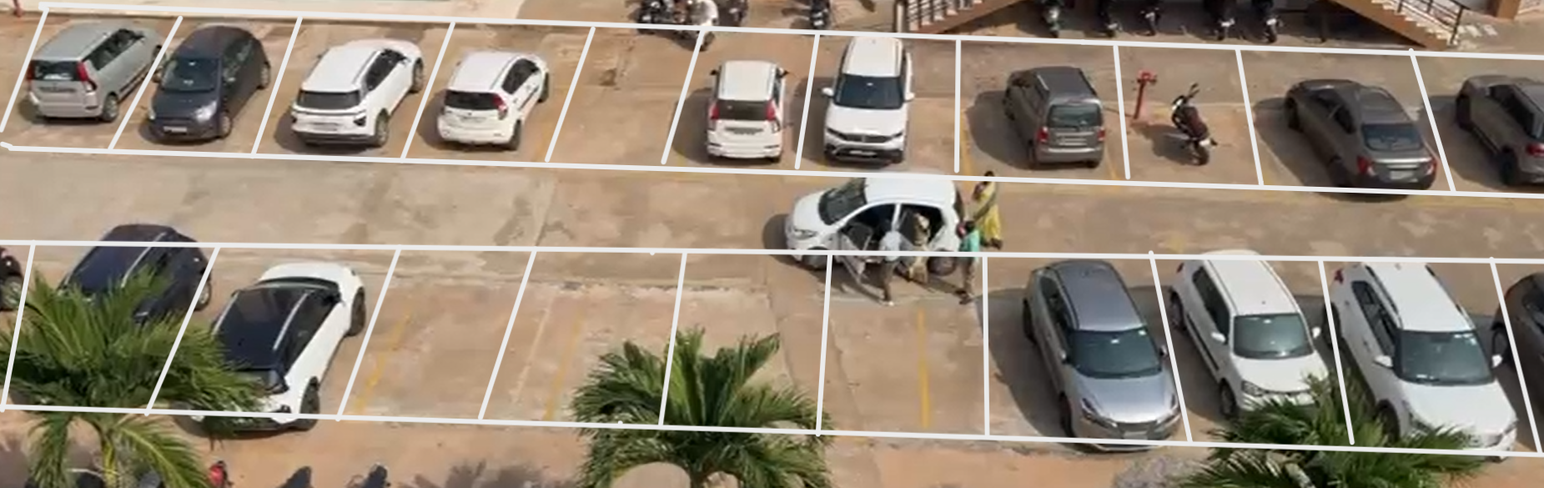
Screenshots of the project
CSE, GST, Visakhapatnam

Slide 13
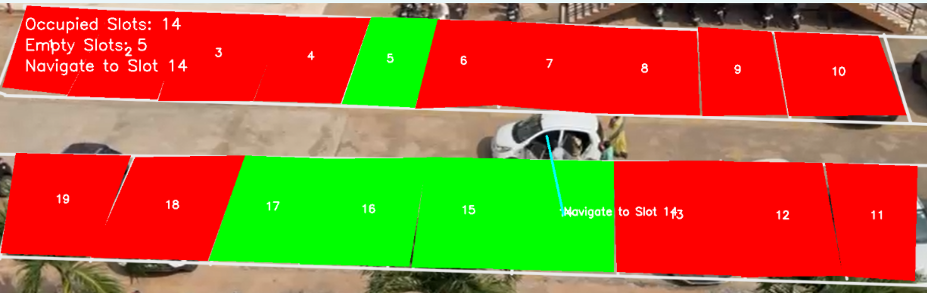
Screenshots of the project
CSE, GST, Visakhapatnam

Slide 14
Results & Discussions
Confusion Matrix
Actual / Predicted | Empty | Occupied
Empty | 5 | 1
Occupied | 0 | 13
Performance Metrics:
Accuracy: 95%
Recall: 100% (All occupied slots detected)
F1-Score: 96% (Balance between correct and incorrect classifications)
F1-Score %)
Model | F1-Score (%)
Faster R-CNN | 89
SSD | 91
YOLOv5 | 94
YOLOv8 (Proposed) | 96
CSE, GST, Visakhapatnam

Slide 15
Conclusion
The Smart Parking System detects occupied and vacant slots using YOLOv8 for real-time vehicle monitoring.
CCTV-based detection eliminates the need for physical sensors, reducing costs and improving scalability.
A Euclidean distance-based shortest path algorithm guides vehicles to the nearest available slot.
The system minimizes search time, reduces congestion, and enhances overall parking efficiency.
FUTURE SCOPE
Wrong Parking Detection
Automated Barrier System:A physical rod (barrier gate) installed at the entrance of each parking plot
License Plate Verification:When a vehicle approaches, the system checks the car's license plate number against the allocated number for the reserved parking slot.
Action Based on Verification:
If the numbers match, the rod lowers, and the vehicle is allowed to park.
If not, the rod remains in position, preventing unauthorized parking.
CSE, GST, Visakhapatnam

Slide 16
References
M. Singh, R. K. Gupta, and S. K. Sharma, "Smart Parking System using YOLOv5 for Vehicle Detection and Tracking," in IEEE International Conference on Dependable, Autonomic and Secure Computing (DASC), 2024. [DOI: 10.1109/DASC64200.2024.00019]
K. Ramesh and B. Sinha, "Enhanced Parking Slot Detection Using YOLOv8," in IEEE International Conference on Emerging Computing and Signal Processing (ICECSP), 2024. [DOI: 10.1109/ICECSP61809.2024.10698155]
A. Patel, R. Verma, and P. S. Rao, "Parking Slot Detection Using YOLO Algorithm," in International Journal of Scientific Research in Engineering and Management (IJSREM), Vol. 5, Issue 2, 2024. [DOI: 10.55041/ijsrem29713]
H. Kim and S. Park, "YOLOv8 Implementation for Smart Parking Management," in IEEE International Conference on Artificial Computational Intelligence (ACCAI), 2024. [DOI: 10.1109/ACCAI61061.2024.10602434]
A. B. Wells and J. L. Turner, "A New Euclidean Shortest Path Algorithm for Tubular Spaces," in Algorithms, Vol. 15, Issue 3, 2024. [DOI: 10.3390/a15030079]
CSE, GST, Visakhapatnam

Slide 17
Thank You
CSE, GST, Visakhapatnam

